Slide 1
Bootstrap in Wordpress
By Shirui Ye
Part of my work samples below:
Boston University BWWC: www.thebwwc.com
LuxCouture Inc: www.luxcouture.com
Designers Circus Inc: http://designerscircus.com
Unibit Inc, web app and its website: https://unibit.ai/login and https://www.unibit.ai/
Union of Minority Neighborhood:
http://unionofminorityneighborhoods.org

Slide 2
Why using Bootstrap in Wordpress?
Not only “Drag and Drop”, Provide a more flexible layout by coding
Make the website unique by adding customized layouts
Make sure the website is 100% cell-phone friendly and responsive

Slide 3
3 ways to implement Bootstrap in Wordpress
Use CDN: login through FTP to edit header.php file and add Bootstrap settings in this file
Add Bootstrap CSS, JS via function.php file
Wordpress Bootstrap Plugin (This is what we are going to focus on today)

Slide 4
Steps to set up Bootstrap Plugin
Login to Wordpress panel
On the left, click on “Plugins” tab, then Add new
Search for Bootstrap. There are many Bootstrap related plugins. Here I use “Bootstrap 3 Shortcodes” as an example.
Click Install Now, then activate it.
Now the plugin is ready to use

Slide 5
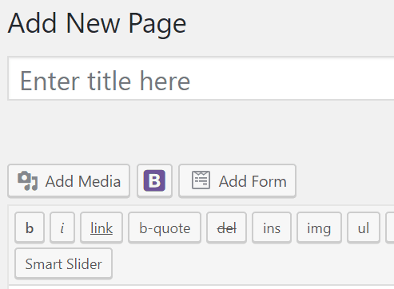
How to use Bootstrap plugin
Click on Pages on the left, then add new
After you download Bootstrap plugin, you should be able to see a purple “B” icon
Click on it, You can see a list of choices. These are exactly the same settings from official Bootstrap website.
Let me demo how to use from here.

Slide 6
Example of how to use
Click Add new
I personally use SiteOrigin (A page building plugin), so I need to click page builder→Add widget→SiteOrigin Editor
In SiteOrigin Editor, you can see a “purple B” sign, click on it and insert Bootstrap layout. (If you don’t use page building plugin, you can see a “purple B” directly after clicking add new.
Click the “purple B” button and choose an item you want to add
Then add your contents between the item’s codes

